Slide 1

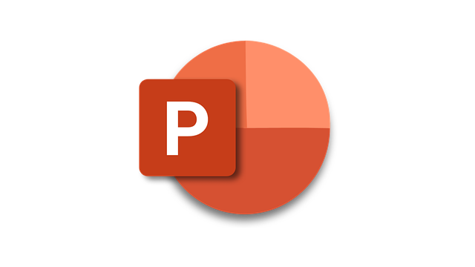






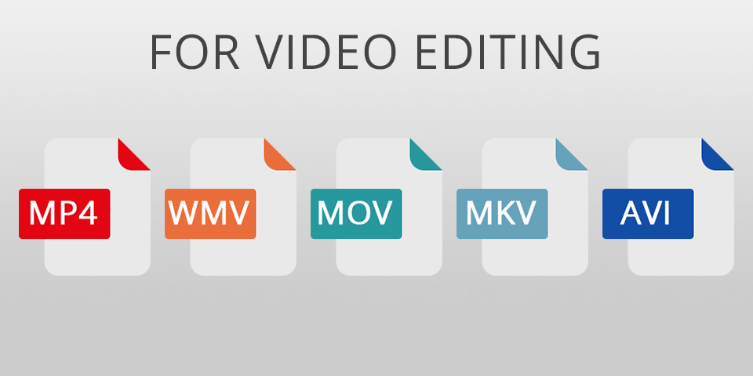


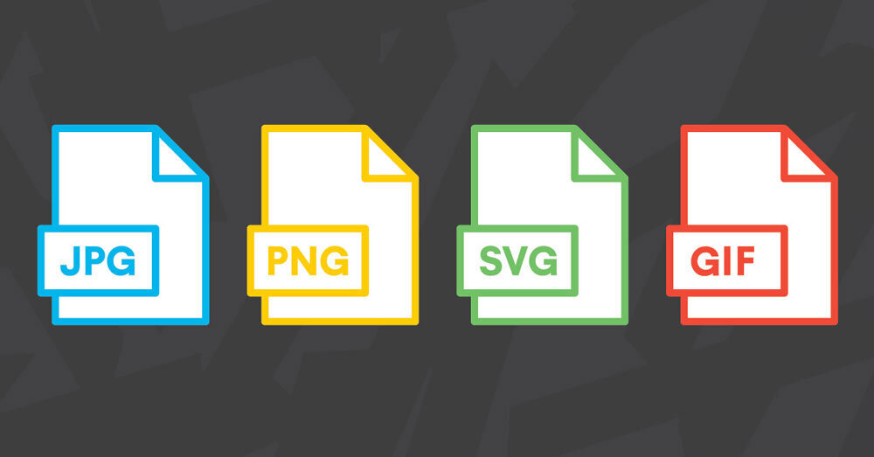



Home
Home
Multimodal Web Page
Microsoft PowerPoint
Apple
Keynote
Read
Listen
Watch
SCORM
SCORM
Learning Management Systems (LMS)
Your Website
Video
Video Sharing
Images
Slide Sharing
Notes:
Multimodal Slides can convert your PowerPoint content into a multimodal web page that one can read, listen to, or watch.
{CLICK}Slide-based tools like Google Slides, Microsoft PowerPoint, and Apple’s Keynote already have some built-in ways to easily share your content.
{CLICK}These slide-based tools can already be exported to a PDF file or to various image formats like JPEG or PNG.
{CLICK}The PDF files, image files, or the PowerPoint file, itself, can be upload to a slide sharing site like Slideshare.net or SpeakerDeck.com.
{CLICK}One can also create a voice-over and export the presentation as a video file, or just an audio file.
{CLICK}That file can then be easily shared by uploading it to YouTube or Vimeo.
{CLICK}For most Learning Management Systems, there are available processes to package a PowerPoint file into the LMS standard SCORM file format.
{CLICK}Multimodal Slides can also produce a SCORM package, or the Multimodal Slides web page can simply be added to your website.
Overall, you can do more with your slides.

Slide 2
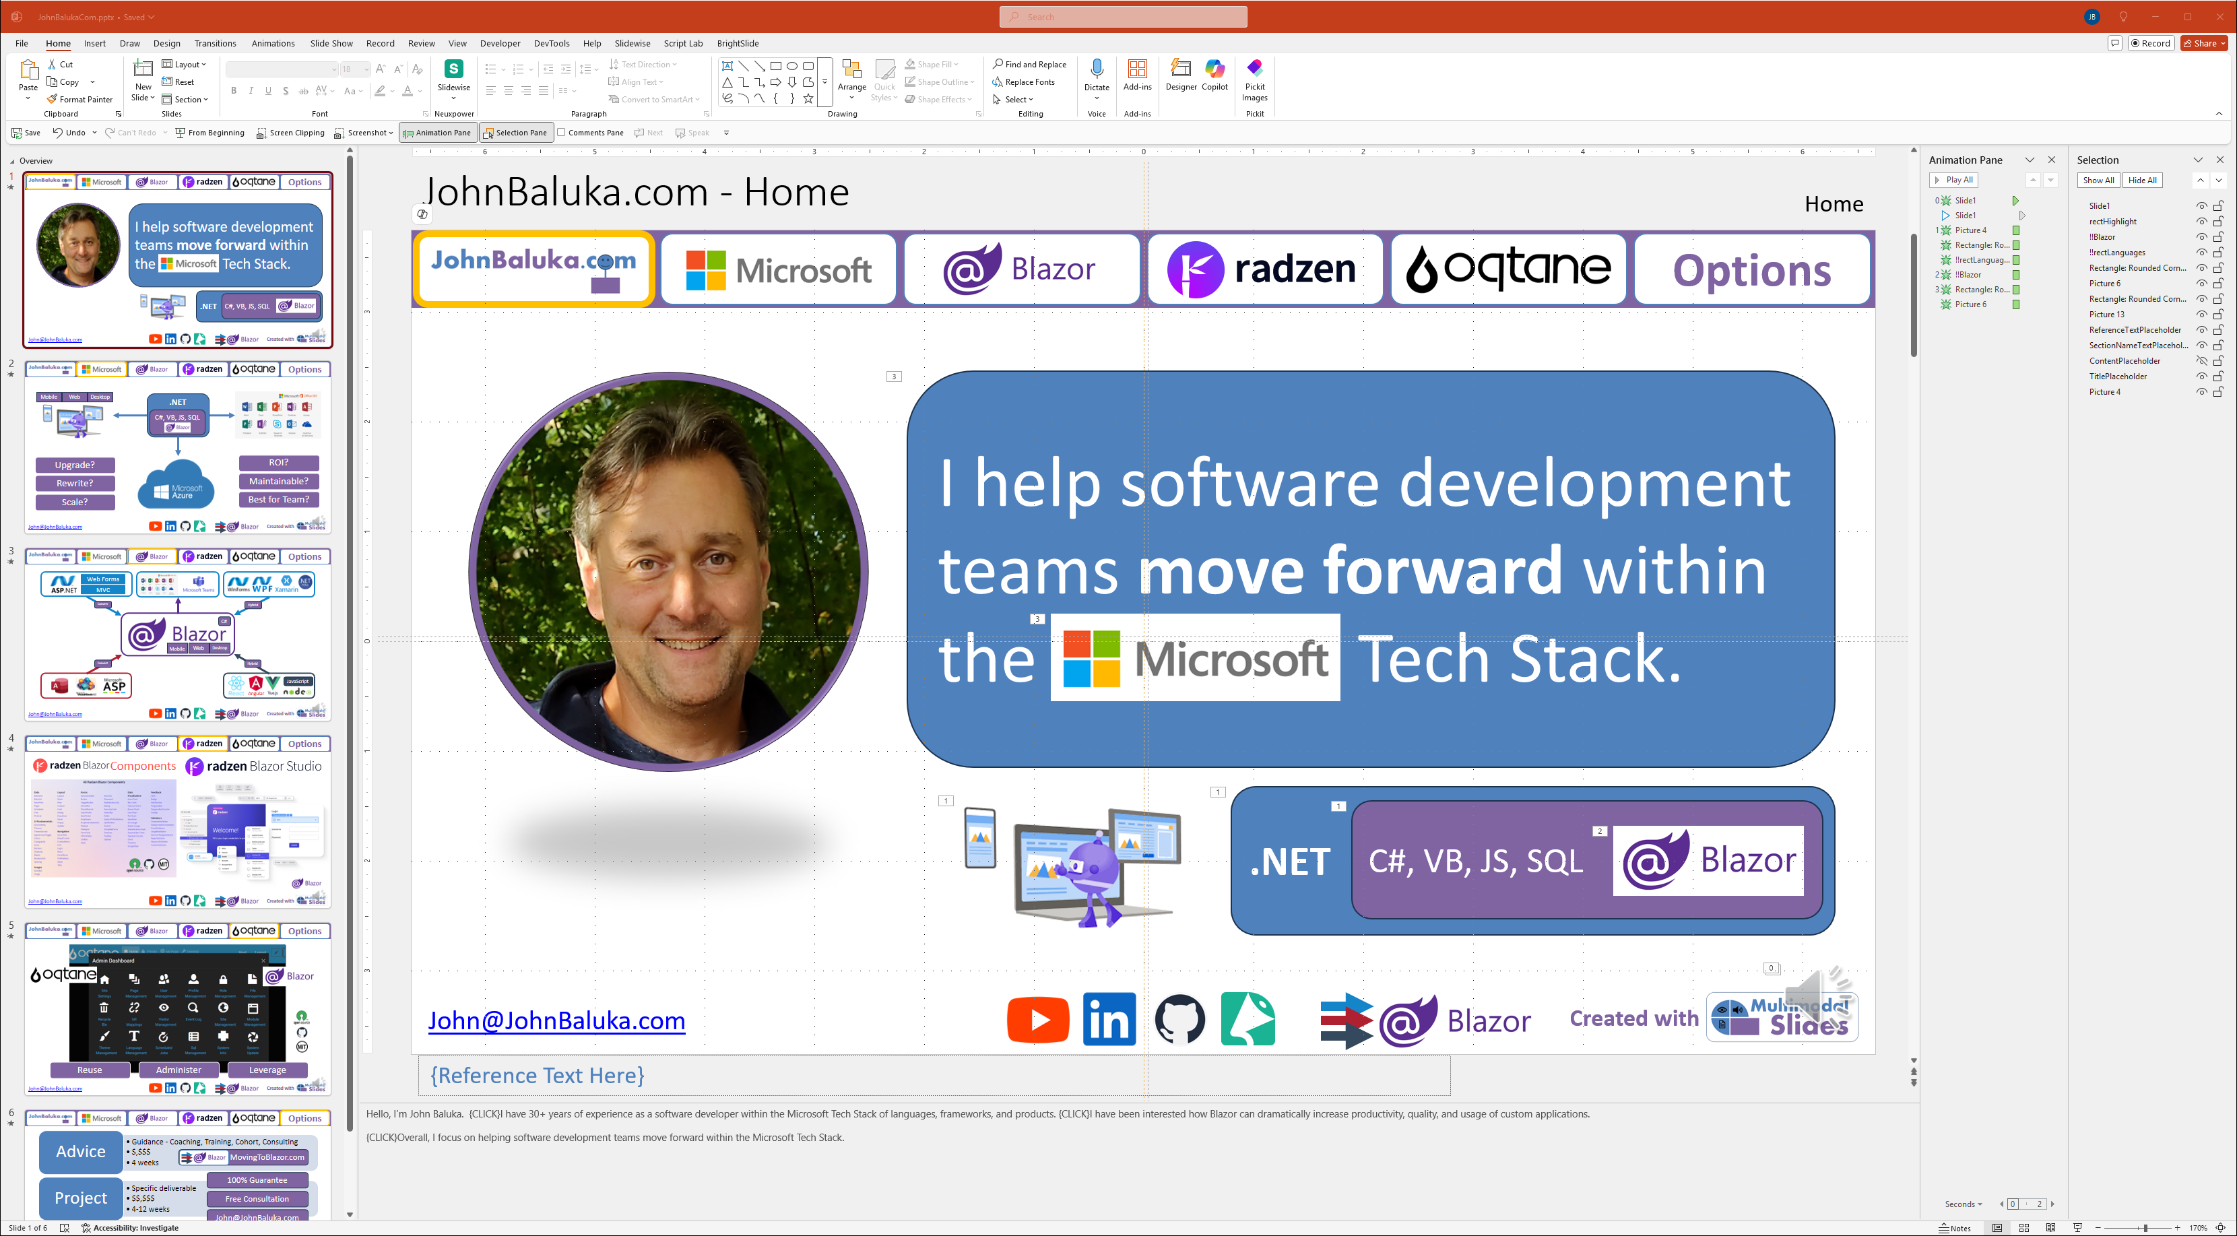

Create
Create
Microsoft PowerPoint
or
Text-to-Speech
Notes:
For example, I simply used PowerPoint to create my website at JohnBaluka.com. I also added external links and {CLICK}internal links to jump to certain slides within PowerPoint that are also carried over into the web page.
{CLICK}Along with all the various visual elements, I added animations to where various elements would appear on a mouse click or keystroke.
{CLICK}I used the “Notes” for transcript of the slide. Within the transcript, I indicated with the word “CLICK” when an animation should be triggered.
{CLICK}To manually record a voice-over, otherwise known as a “Narration”, I clicked on “Record”, which opened a recording window.
{CLICK}Once the recording for each slide is complete, an audio clip appears in the lower right-hand corner. One of the best features of recording a voice-over in PowerPoint is that the audio is saved per slide, therefore if you need to re-record something, you just re-record certain slides.
{CLICK}Multimodal Slides has a Text-to-Speech feature. For my website, I used ElevenLabs to clone my voice. Multimodal Slides can use ElevenLabs to convert the transcript into an audio file along with making sure that the various animations are triggered at the right moment.
And yes, this website, MultimodalSlides.com, I used the same approach, and my voice-over is a clone.

Slide 3











Convert
Convert
Installed Application (Windows Only)
Multimodal Web Page
Results on your computer or your LAN
File Upload Link
Read
Listen
Watch
Notified once complete with a Download Link
Image Files
File Share
Audio / Video Files
Slide Note Files
New Folder created in your File Share
Viewer Application
File Repository
Index.htm
New Folder created in your File Repository
Notes:
The process to convert a PowerPoint file to a Multimodal web page can be handled in four different ways.
{CLICK}The first way is to install the Multimodal Slides application that is currently Windows only. This application will simply put the results into a folder on your computer or Local Area Network.
{CLICK}Or the second way, you could upload the PowerPoint file. Once the Multimodal Slides server conversion process is complete, a download link will become available to get the results in a .zip file.
{CLICK} Or the third way, you could share your PowerPoint file over Dropbox, Google Drive, box.net, or OneDrive. The Multimodal Slides server process can auto-detect a file change, or get manually triggered, to process the PowerPoint file. The results will be placed in a new folder within your file sharing service.
{CLICK} Or the fourth way, you could utilize a shared file repository that has built-in version control like GitHub, Bitbucket, Azure DevOps, or SharePoint. Like the third option, the Multimodal Slides server process can auto-detect a file change within the file repository or get manually triggered to process the PowerPoint file. The results will be placed in a new folder within your file repository.
{CLICK}The results of the conversion process that encompass a Multimodal web page are {CLICK}the image files which consists of images in the slides and the slides, themselves.
{CLICK}The audio and video files are placed in a separate folder.
{CLICK}The transcript for each slide that comes from the Notes are placed in a separate folder.
{CLICK}The viewer application is in a separate folder, which means that you do not need to install any special program to handle the viewer.
{CLICK}And finally an “index.htm” file is created as an easy way to double-click, or host on your website, with the other sub folders.
There are pros and cons to each of these ways to convert your PowerPoint file. You will need to choose what is best for you and your workflow.

Slide 4
Publish
Publish
Multimodal Web Page
Your Website
WordPress, Umbraco, Orchard, …
Your Custom Website
GitHub Pages (Stand-alone Website)
Read
Listen
Watch
Your Platform
Learning Management System (LMS)
Content Management System (CMS)
Wiki
Image Files
Audio / Video Files
Slide Note Files
Custom Application
Viewer Application
Fully Integrated Solution
Self Hosted or Managed Hosted
Web, Mobile, and/or Desktop
Index.htm
Notes:
The web page created by Multimodal Slides can be published and integrated in multiple ways.
{CLICK}First, it can simply be added to your website. You could be using WordPress, Umbraco, Orchard, or one of the many other options. You may have a custom web site that makes it even easier to integrate. You could also host a free website on GitHub Pages and make it a stand-alone website.
{CLICK}Second, if you are invested into a workflow platform, like a Learning Management System (LMS), Content Management System (CMS), or a Wiki, then a special import package like SCORM can be created, or a special API connection and process, can be handled within Multimodal Slides.
{CLICK}Third, do you need a fully integrated solution? Something that is self-hosted or managed-hosted? Along with a web application, do you also need a mobile or desktop application?
The Multimodal web page can be published and shared in a manner that best suits your needs and those of your organization.

Slide 5

Roadmap
Roadmap
Design for Mobile, SEO, and Accessibility
Fully Automated Service
(Per File or Subscription)
Better Formatting in Notes / Text / Transcript
More Viewing Options (Modes)
Presentation Mode
Reading Mode
Video Player Mode
Article Title
Article Title
Current Slide
Notes
Slide
Video /
Current Slide
Notes
Slide
Notes
Slide
Notes
Slide
…
…
Notes:
Here are some of the features on the roadmap.
{CLICK}The output from Multimodal Slides will continue to evolve to better support mobile (small screen) devices, Search Engine Optimization, and accessibility needs.
{CLICK}I am working through providing better formatting capabilities in your Notes -- the transcript of the presentation. The use of Markdown is a popular request. Also, the use of external tools like Microsoft Word to be used instead of the Notes section in PowerPoint is getting tested.
{CLICK}The primary goal is to provide more viewing options, otherwise known as modes.
{CLICK}The Presentation Mode is the current available experience. It is a similar experience on how you can share an embedded PowerPoint or Google Slides presentation without the player capability.
{CLICK}The Reading Mode has more of a Blog Post look and feel. It is a nice alternative for someone that wants to quickly scroll through the content.
{CLICK}The Video Player Mode is a combination of the Presentation Mode and the Reading Mode. As the presentation plays, the notes and slide thumbnails scroll with the player.
{CLICK}A fully automated service will eventually be available, allowing users to pay per file for a few dollars or subscribe to better utilize the Multimodal Slides platform.
If you don’t want to wait, feel free to review my options on how we can work together.

Slide 6
Options
Options
Conversion
Process a Handful of Presentations
$,$$$
1-4 days
100% Guarantee
Website
Process and Deploy
$$,$$$
4-12 weeks
Free Consultation
John@MultimodalSlides.com
Workflow
Implement a “Process and Deploy” Workflow
$$$,$$$
6-12 months (with deliverables every 4 weeks or less)
Notes:
Until this service can be fully automated, I have three options for how we can work together.
{CLICK}First, we can have a Conversion with a handful of your presentation files. This allows you to see and work with the results. The price for a Conversion is usually within four figures, and the turnaround time is within days. From there, you can publish the results to your website.
{CLICK}Second, once you are satisfied with one or more Conversions, then needing help setting up, or integrating into, a website could be your next step. The price for processing and deploying to your website is usually within five figures and usually spans between four and twelve weeks.
{CLICK}Third, if you expect you’ll need to update your website often, then you will need some workflow automation to process and deploy to your website on a regular basis. The price for a Workflow implementation is usually within six figures, and the duration is usually between six and twelve months.
{CLICK}For everything I do, I provide a 100% guarantee for my work.
{CLICK}I always start with a Free Consultation to see if there is a good fit.
{CLICK}To start the conversation, email me at John@MultimodalSlides.com. I look forward to hearing from you.
Also feel free to learn more about me at JohnBaluka.com, check out the Multimodal Slides YouTube channel, download this content as a PDF, download this source PowerPoint file that created this website, or check out the GitHub Pages repository where this website is hosted.
Of course, this website, MultimodalSlides.com, was created within the platform, I would appreciate any feedback to help me make it better.

